Slide 1


The Globalizing K-Pop Project: Sentiment Analysis of Global Fandoms on Social Media
This research delves into the world of global K-Pop fandoms, seeking to understand the sentiment expressed by fans on social media platforms. By analyzing online discussions, we aim to identify the emotions, opinions, and support networks within these communities, shedding light on the cultural impact of K-Pop and its role in fostering global interconnectedness.
Prepared by:
Aditi, Gunpreet, Krish

Slide 2

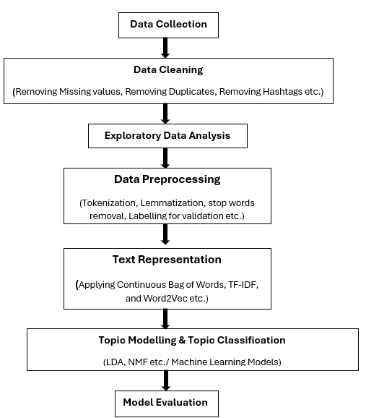
K-pop Project- Research Workflow
Data Source
1
This project utilizes Reddit as the primary data source.
2
Web Scraping
Data Cleaning
3
4
Natural Language Processing (NLP)
NLP techniques are applied to prepare the data for sentiment analysis. This involves language processing, stemming, or lemmatization, depending on the language of the comments, to standardize the textual data and extract meaningful insights.
Topic Modelling and Topic Classification
5

Slide 3
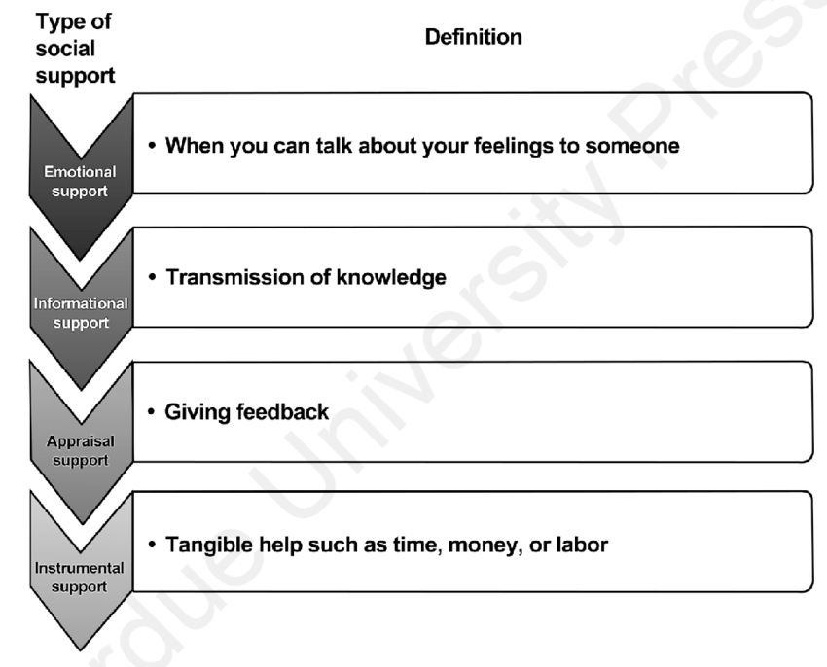
Data Collection
Subreddit Selection
Smaller fandoms for more fan interaction
Subreddits Used: SF9, EXO, Red Velvet, Twice, Super Junior
Data Collection:
Using PRAW for data collection
Filtered and Unfiltered data for all subreddits
Filtering:
Filtered using the keyword list from last year
Manual Labeling:
Chose SF9 for manual labeling
Categories: Emotional, Informational, Appraisal, Instrumental

Slide 4
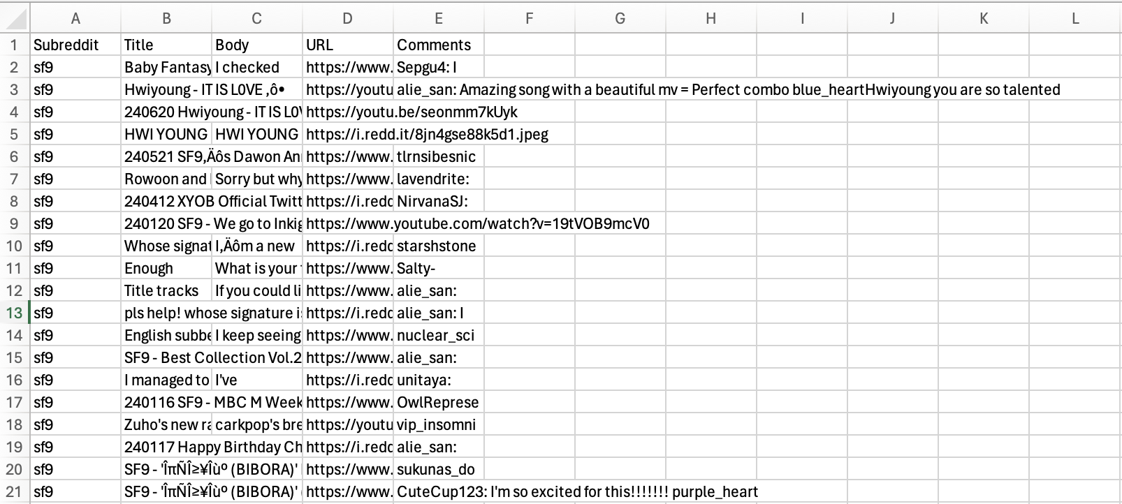
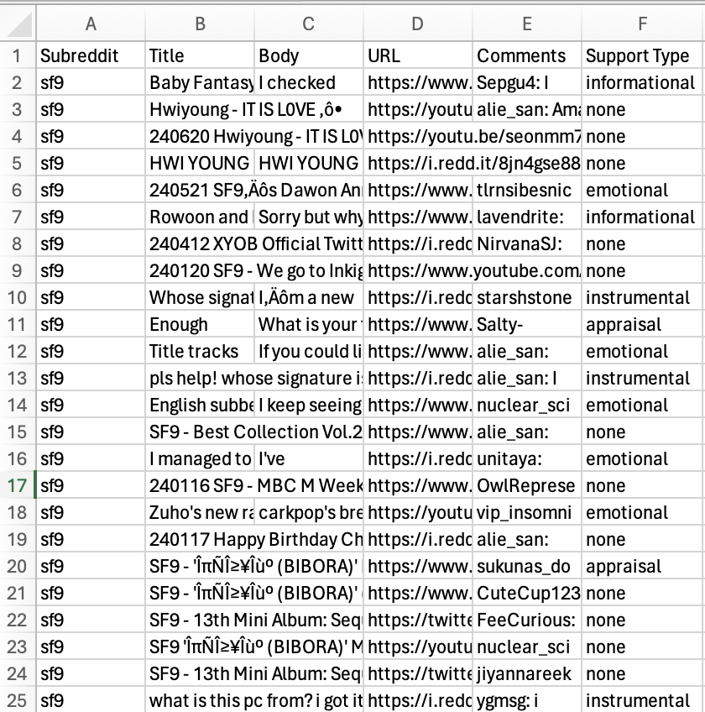
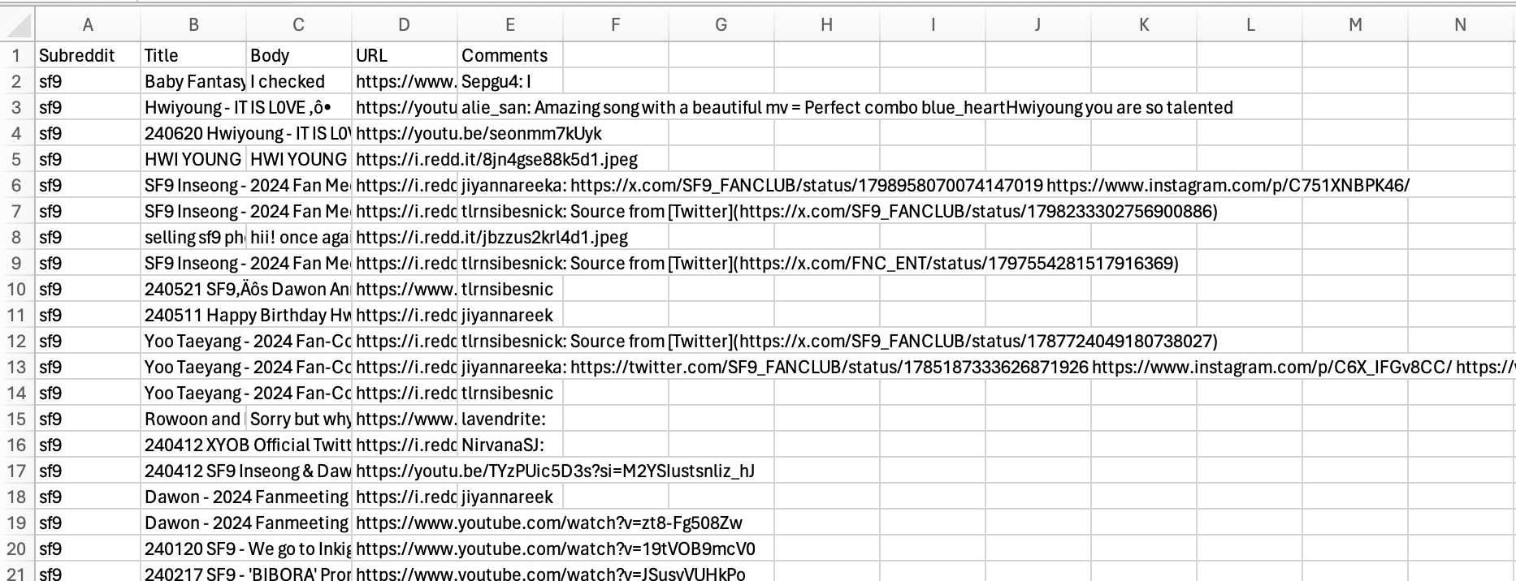
Data Collection
Unfiltered
Manually Labelled
Filtered

Slide 5
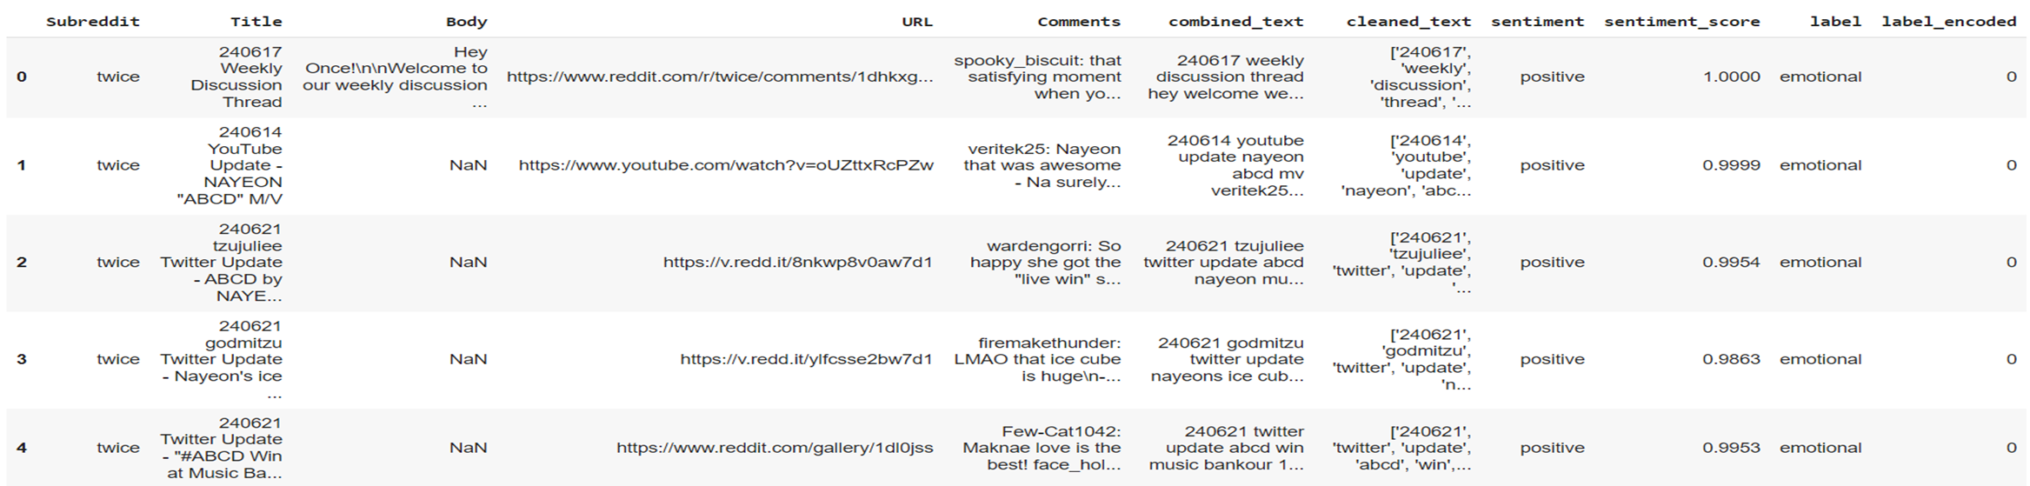
Data Pre-Processing
Removing Hashtags
Removing Special characters(like *,^ etc.)
Removing Emojis and converting meaning to text
Removing Subreddits( e.g. /r which we get due to reddit)
Removing Punctuations
Lowering case
Remove Stopwords
Tokenization(Convert sentences to tokens or words)
Lemmatization( Convert word to root form and compare with vocabulary)
https://colab.research.google.com/drive/1H_Yv-OKVQZHWF76ZacX0KAAFhZqpo8cO?usp=sharing

Slide 6
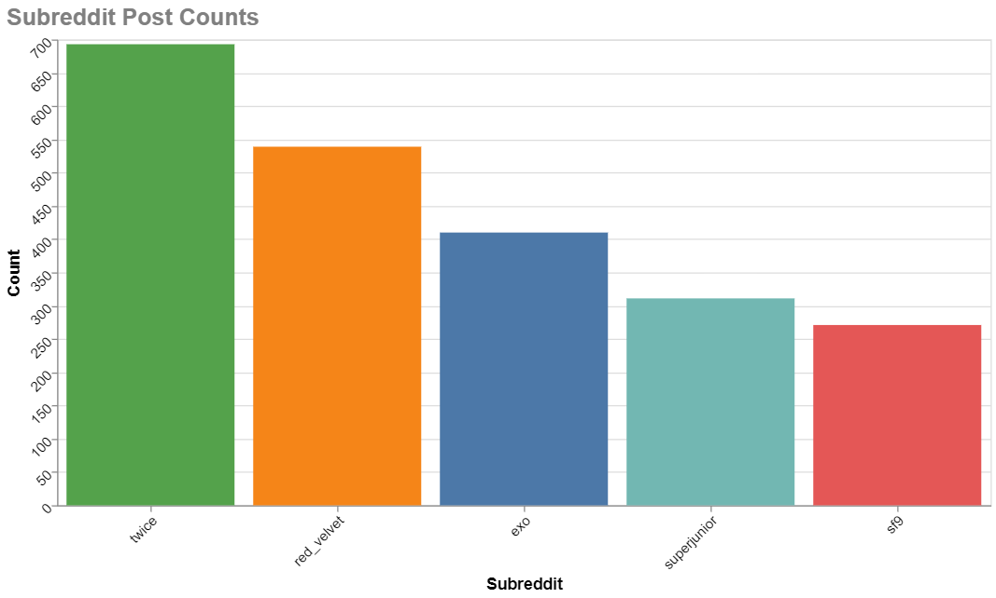
Text Representation: Mapping Words to Meaningful Vectors
TF-IDF
Word2Vec (CBOW)
The Term Frequency-Inverse Document Frequency (TF-IDF) technique is used to calculate the importance of words within the dataset. This weighting scheme considers the frequency of words in each comment and their overall presence across the entire dataset. Words that appear frequently in a particular comment but are relatively rare across the corpus are deemed more significant.
Word2Vec is a neural network-based model that creates dense vector representations of words. The Continuous Bag of Words (CBOW) model is particularly effective in capturing semantic relationships between words. By representing words as vectors, we can understand their meanings and associations, enabling the analysis of sentiment and topics within the data.

Slide 7
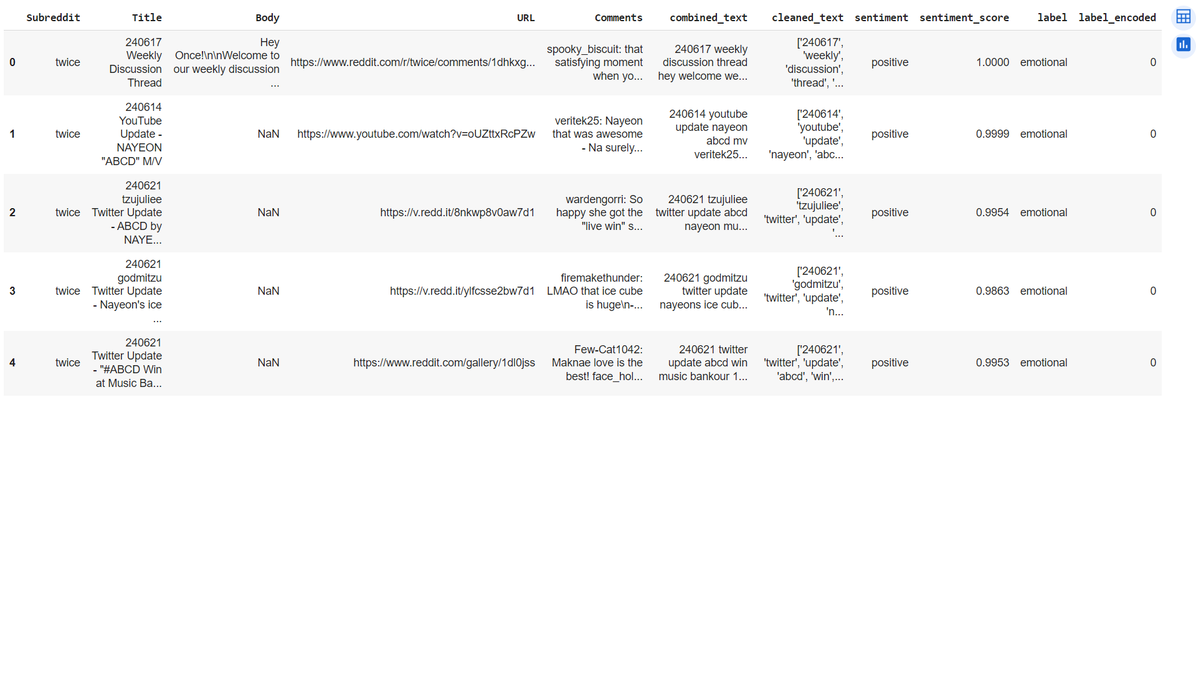
Topic Classification: Supervised Learning
Steps for Topic Classification
Data Preparation: Load and preprocess the text data.
Label Encoding: Encode the topic labels.
Text Vectorization: Convert text data into numerical form using TF-IDF.
Model Training: Train a Naive Bayes model.(SVM(Support Vector Machine),
Naïve Bayes)
5. Model Evaluation: Evaluate the model's performance using metrics such as accuracy, precision, recall, and F1-score.
6. Top Keywords Extraction: Extract and visualize top keywords for each topic.
Fig. Preview of Dataset after labelling

Slide 8
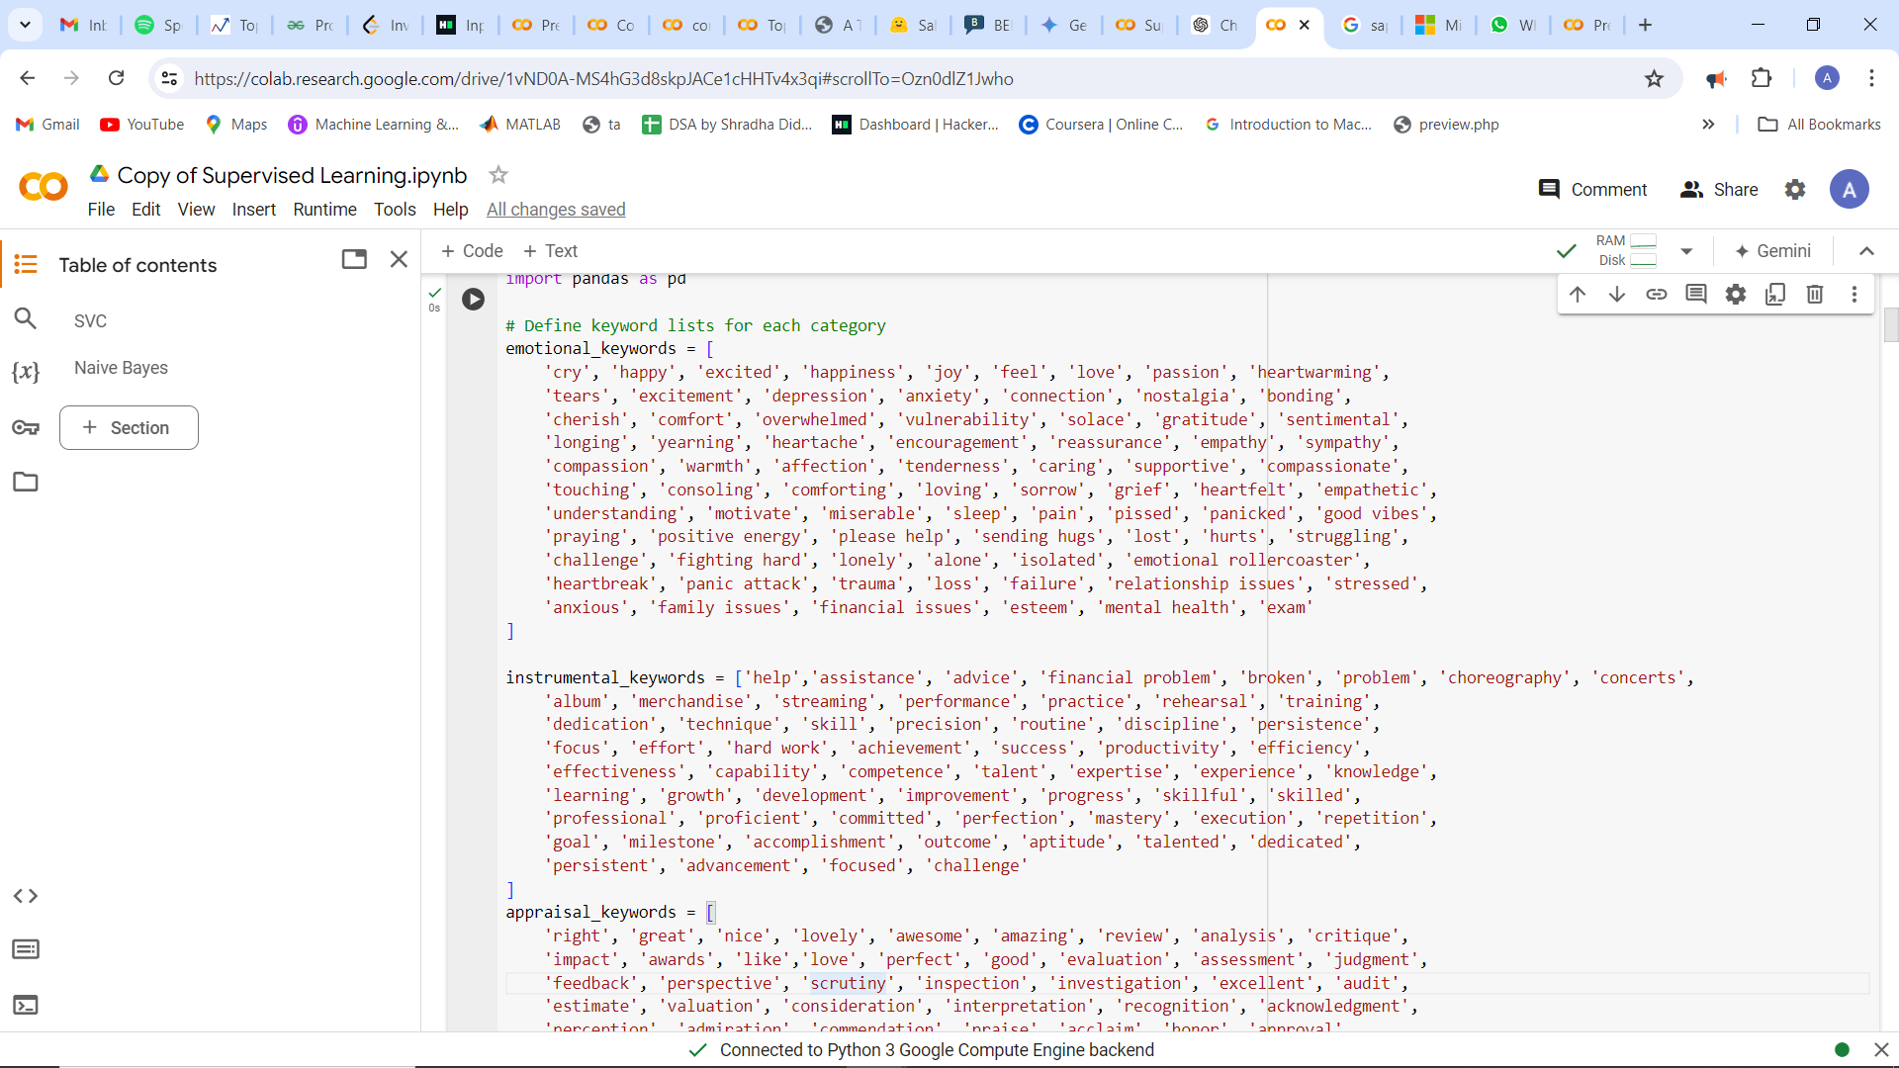
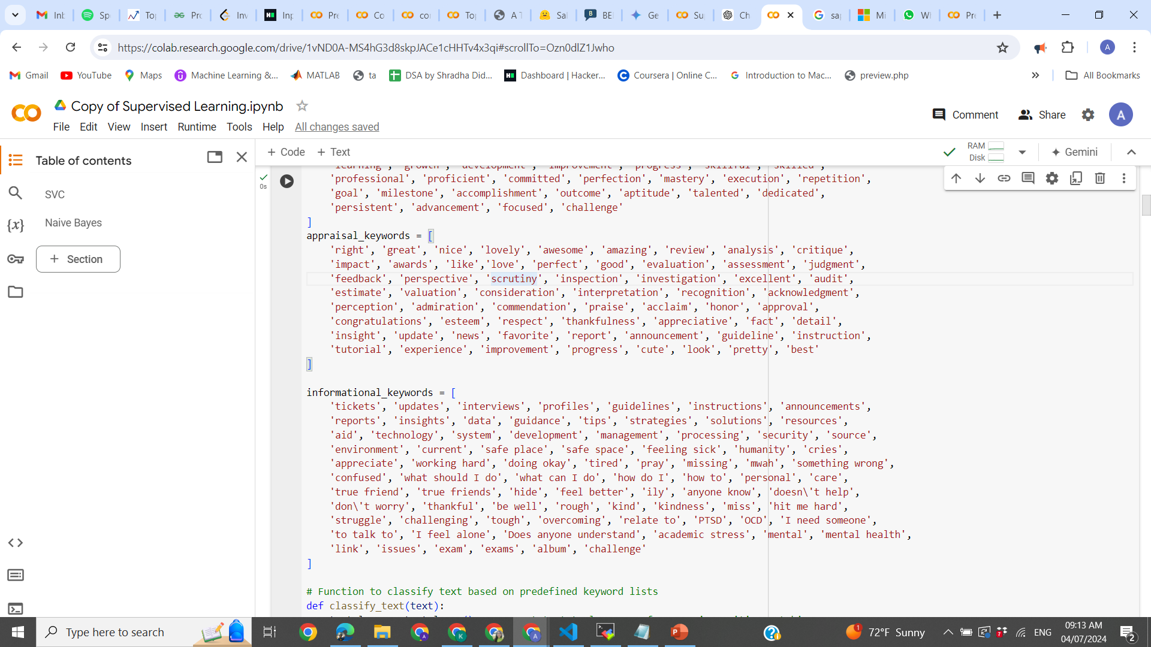
Keywords

Slide 9
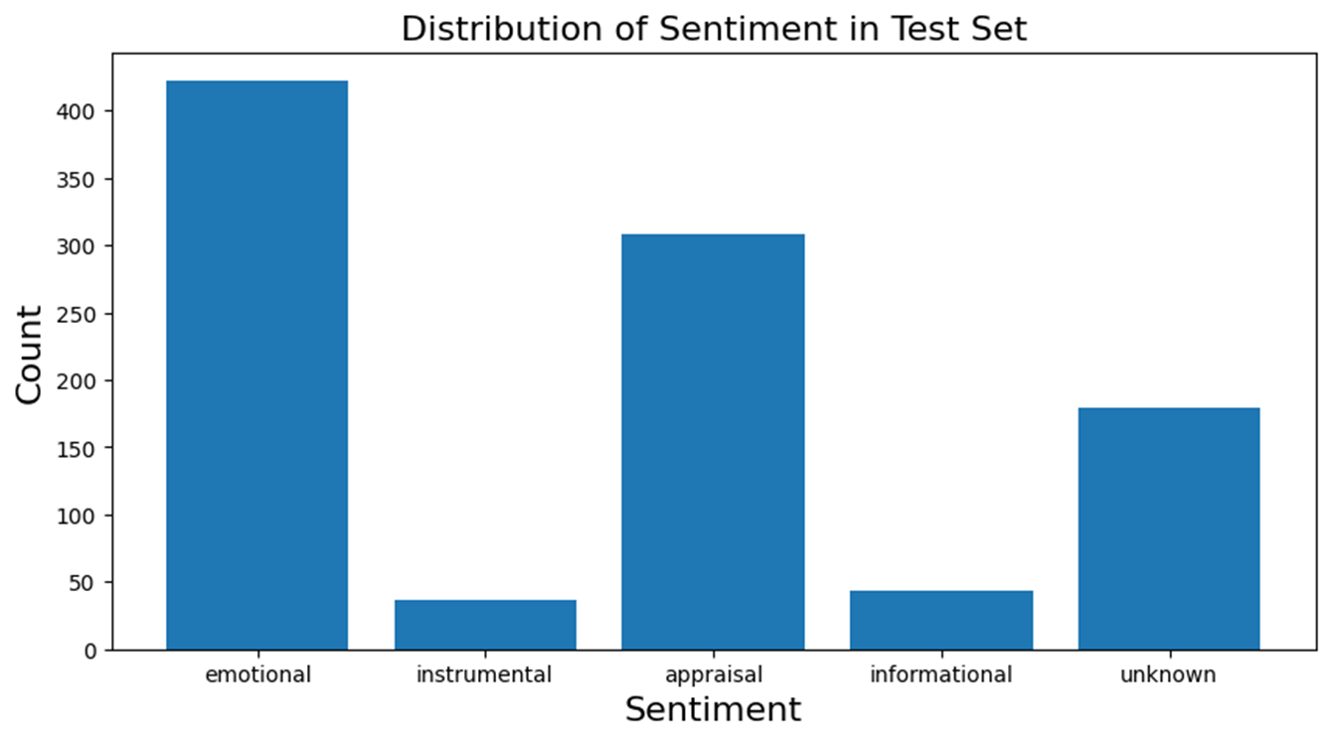
Results of Model Training
Evaluation Metrics | SVM(Support Vector Machine) | Naïve Bayes
Accuracy | 88.82% | 64.02%
Precision | 0.86 | 0.66
Recall | 0.86 | 0.64
F1-score | 0.85 | 0.59
'emotional': 0, 'instrumental': 1, 'appraisal': 2, 'informational': 3, 'unknown': 4

Slide 10
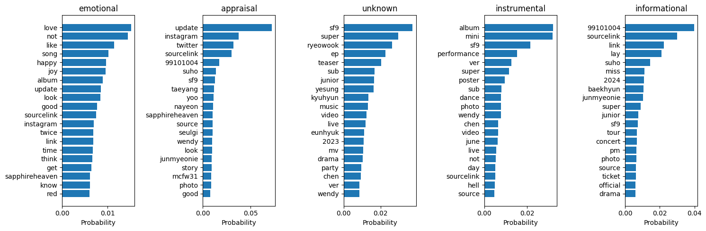
Naïve Bayes
Bar Graph Representation for top words

Slide 11
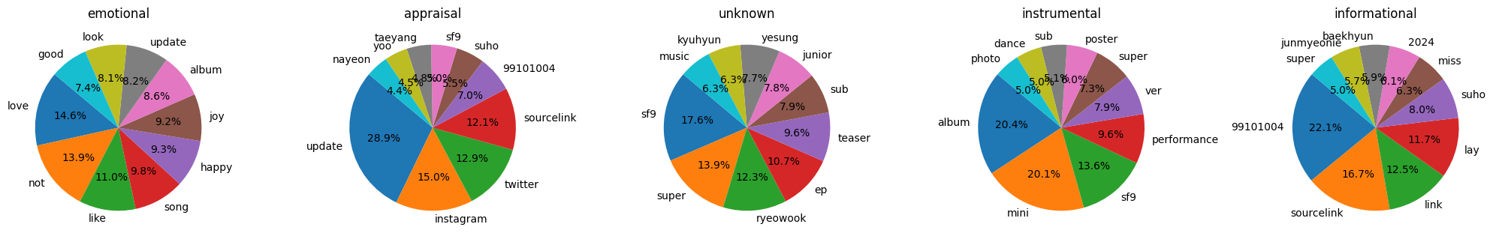
Naïve Bayes
Pie Chart Representation

Slide 12
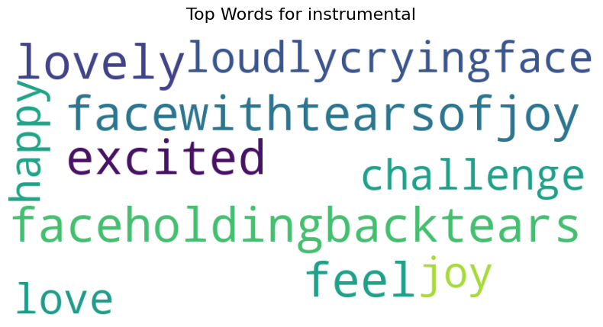
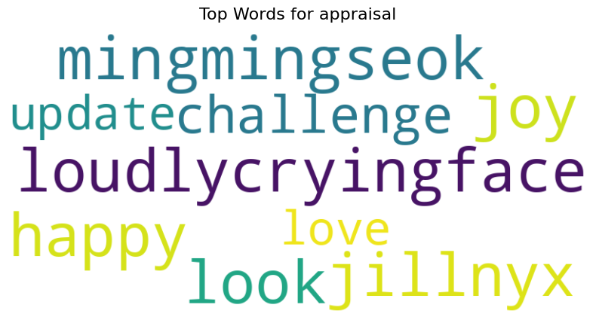
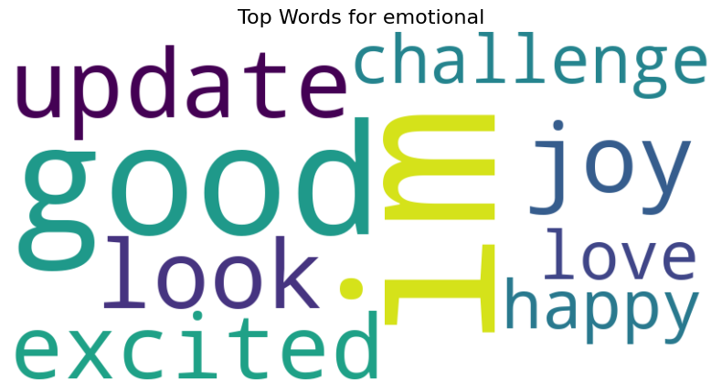
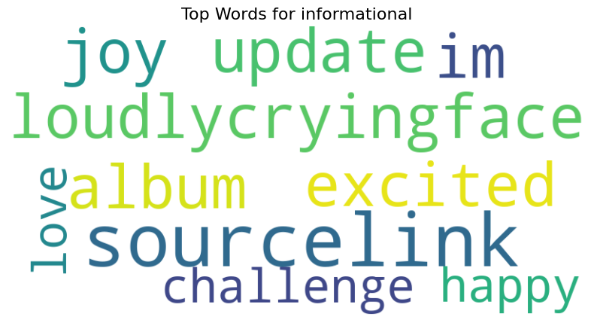
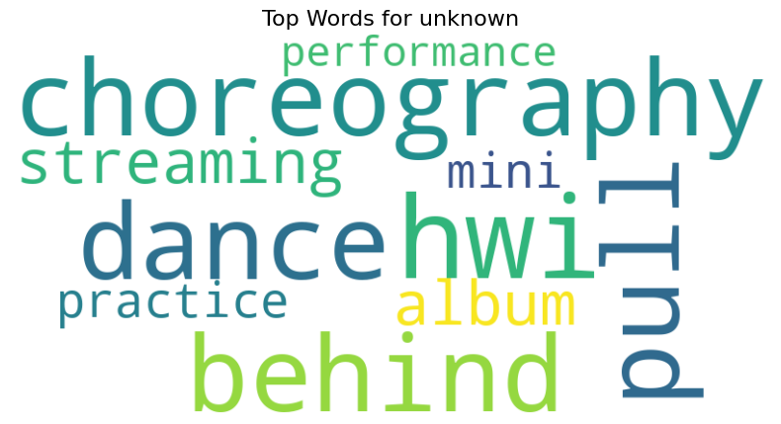
Naïve Bayes
Word CLoud

Slide 13
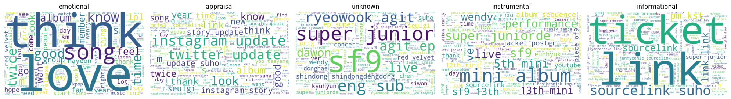
Naïve Bayes

Slide 14
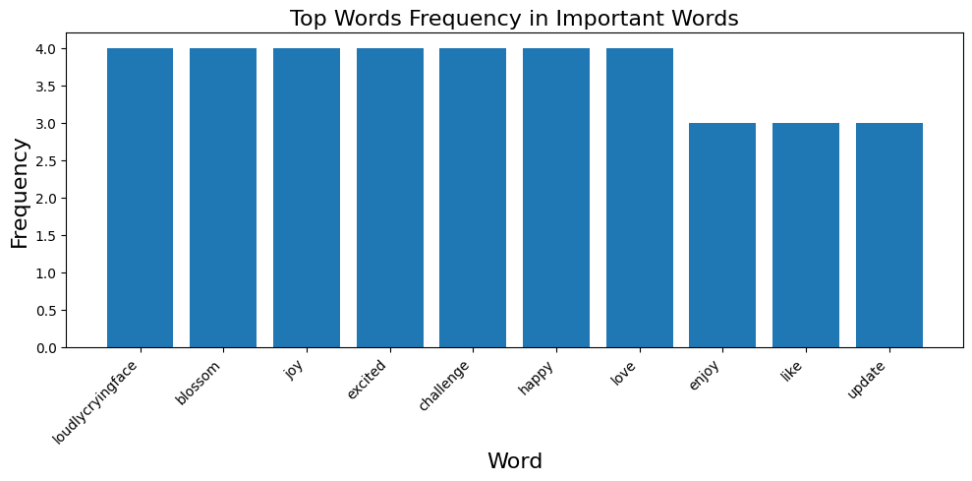
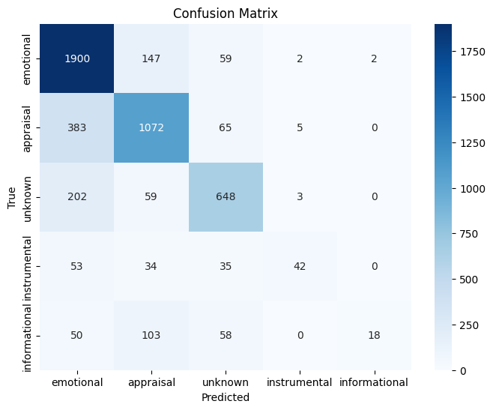
Naïve Bayes
https://colab.research.google.com/drive/1vND0A-MS4hG3d8skpJACe1cHHTv4x3qi?usp=sharing - Code

Slide 15
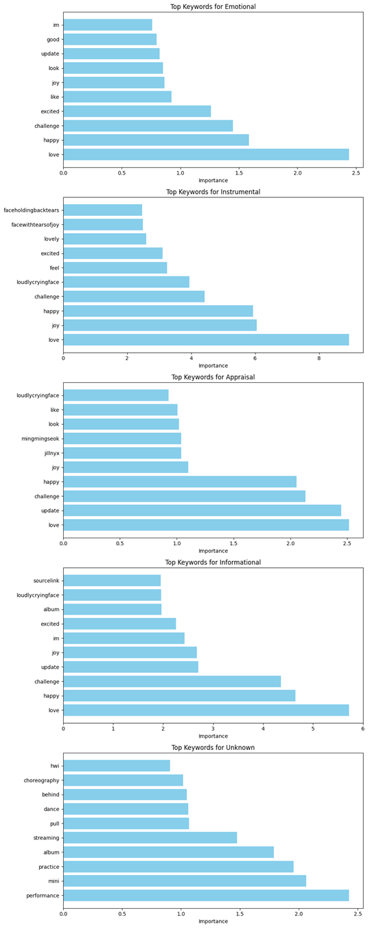

Support Vector Machine
Bar Graph Representation for top words

Slide 16
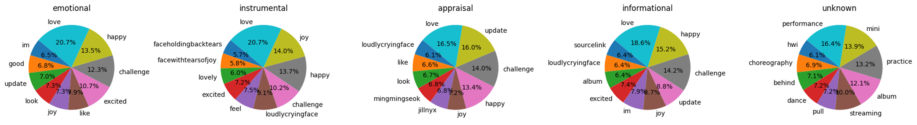
Support Vector Machine
Pie Chart Representation

Slide 17
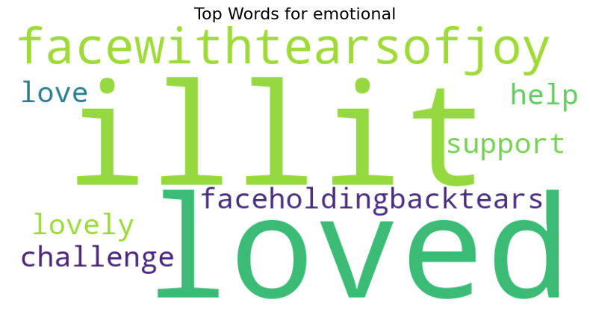
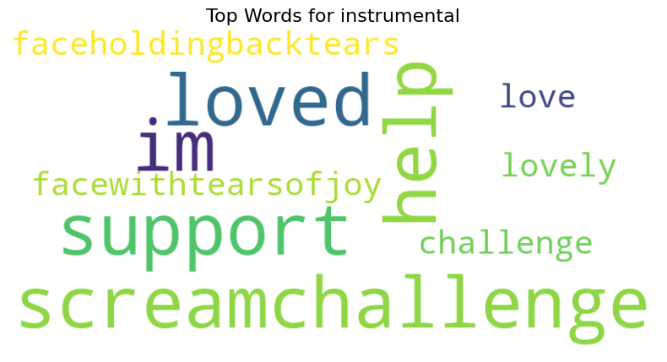
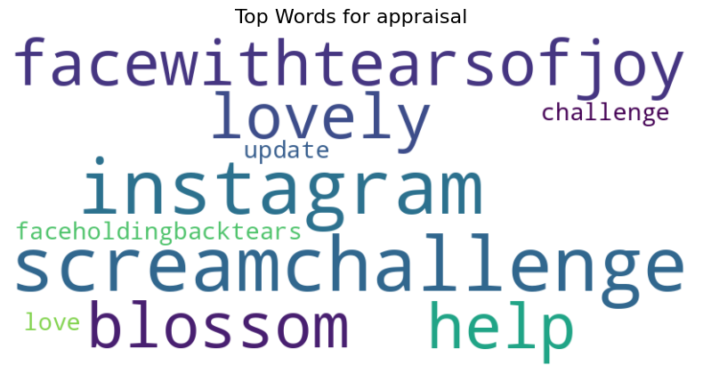
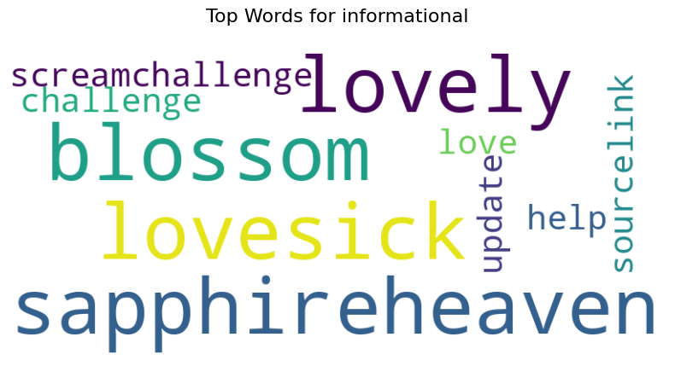
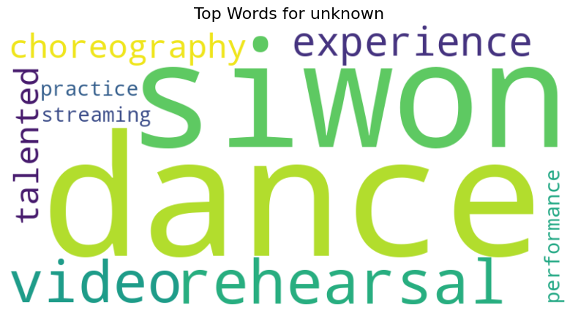
Support Vector Machine

Slide 18
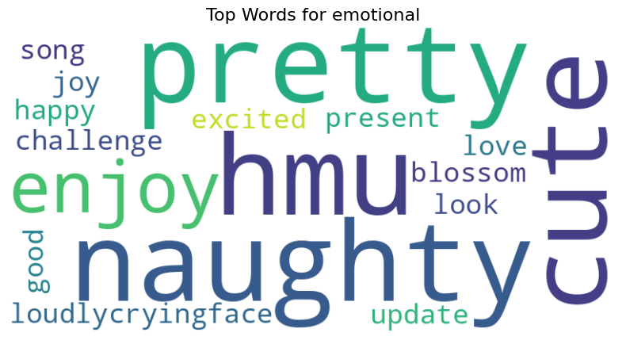
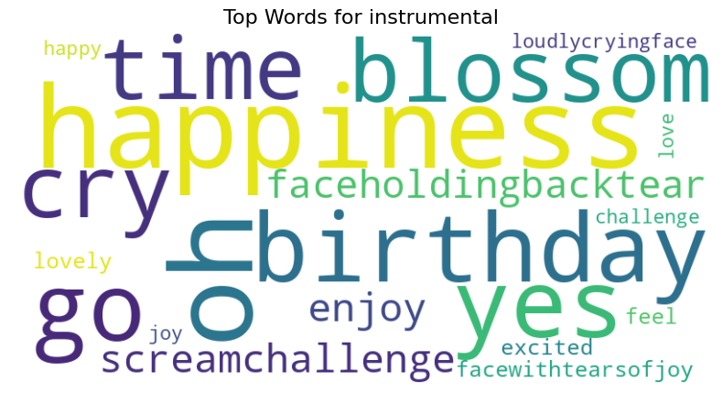
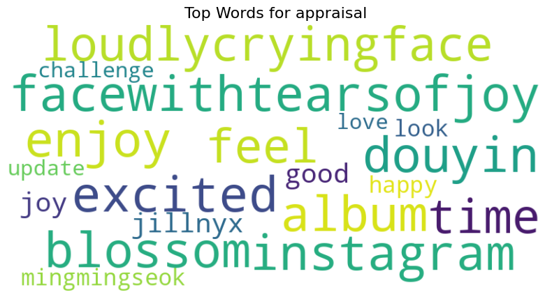
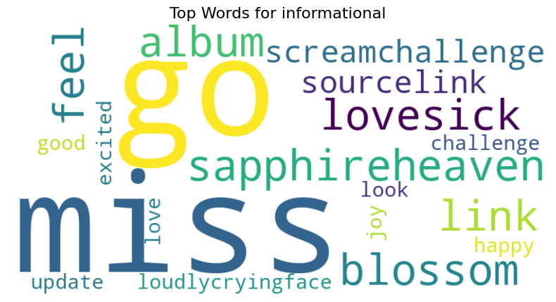
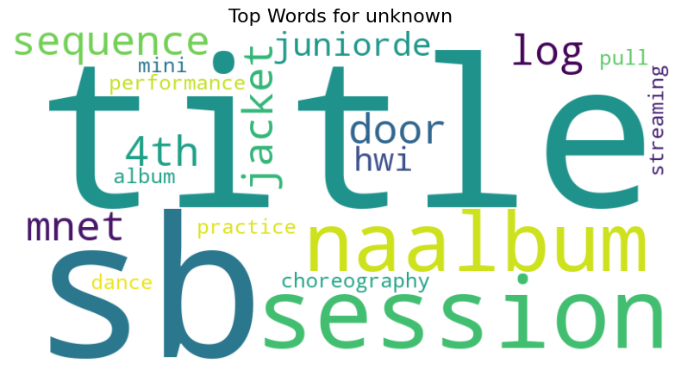
Support Vector Machine

Slide 19
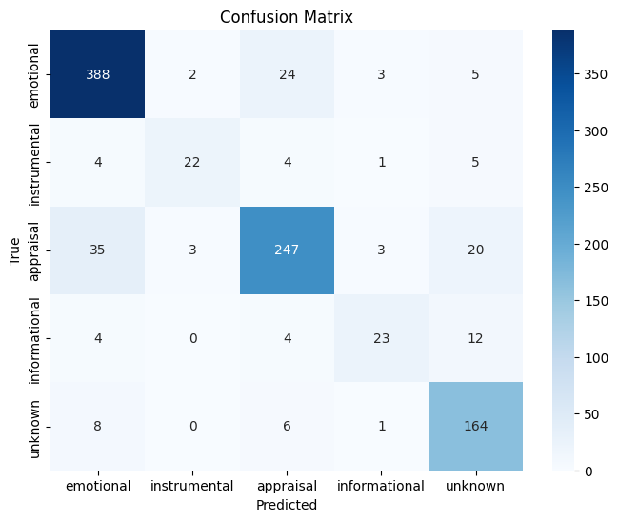
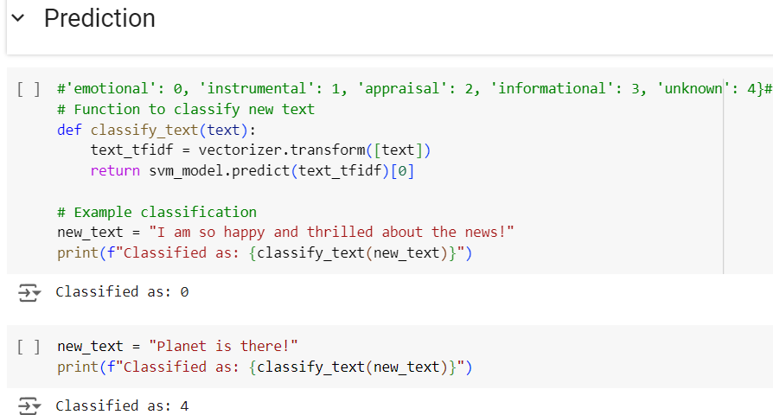
Support Vector Machine

Slide 20
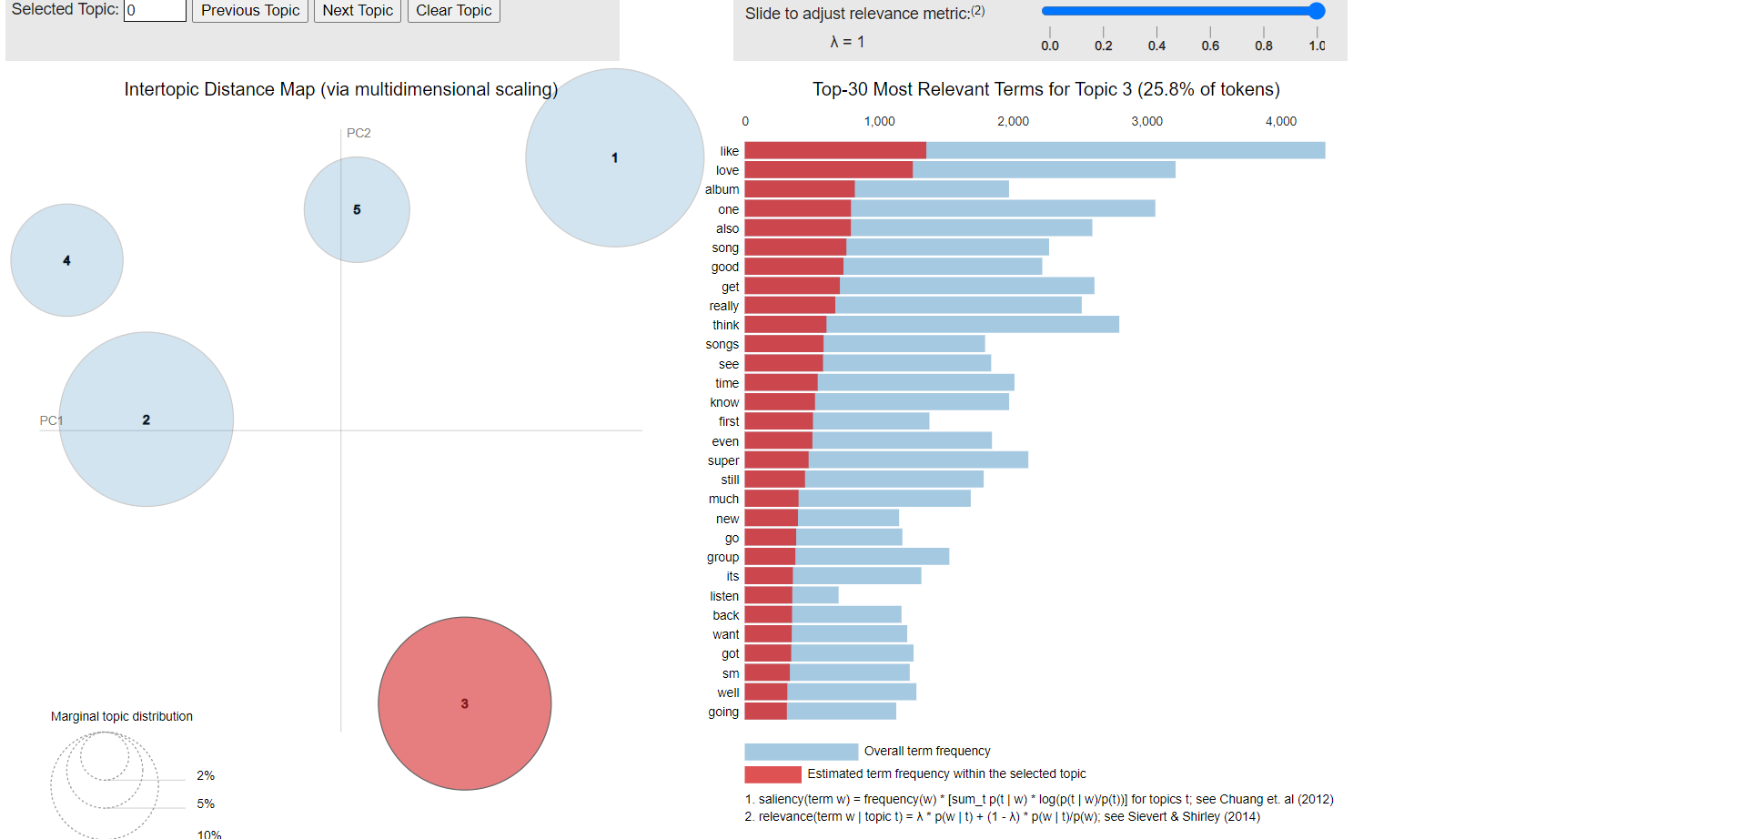
Topic Modelling
LDA(Latent Dirichlet Allocation)
NMF (Non-Negative Matrix Factorization)
https://colab.research.google.com/drive/1iAvYCj32vdBfFHwS2w_HSEcAx6Q3aWim?usp=sharing#scrollTo=T7ESF5-JjwvU

Slide 21
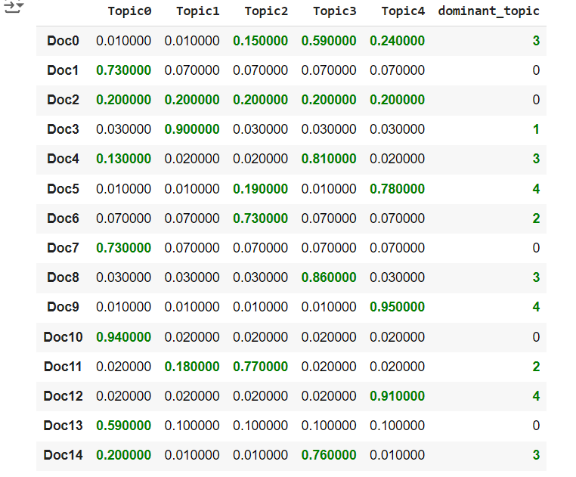
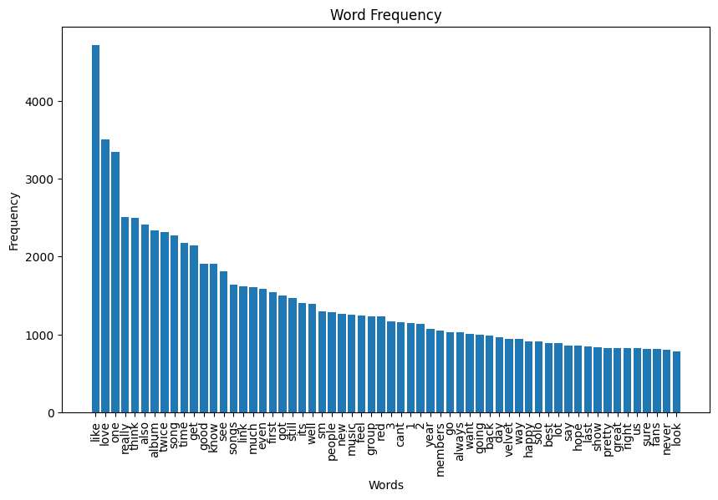
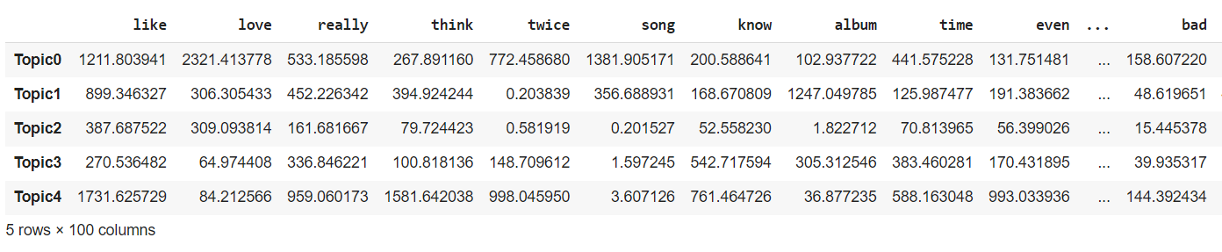
LDA (with Bag of Words)
Top Words from Bag of Words(when n=5)
Top words for Topic #0:
['feel', 'really', 'favorite', 'first', 'good', 'twice', 'songs', 'like', 'song', 'love']
Top words for Topic #1:
['new', 'song', 'songs', 'think', 'chill', 'solo', 'rv', 'really', 'like', 'album']
Top words for Topic #2:
['good', 'really', 'pretty', 'super', 'twitter', 'love', 'like', 'look', 'looks', 'update']
Top words for Topic #3:
['hope', 'new', 'live', 'really', 'version', 'time', 'know', 'got', 'thank', 'happy']
Top words for Topic #4:
['members', 'group', 'know', 'still', 'really', 'even', 'twice', 'people', 'think', 'like']

Slide 22
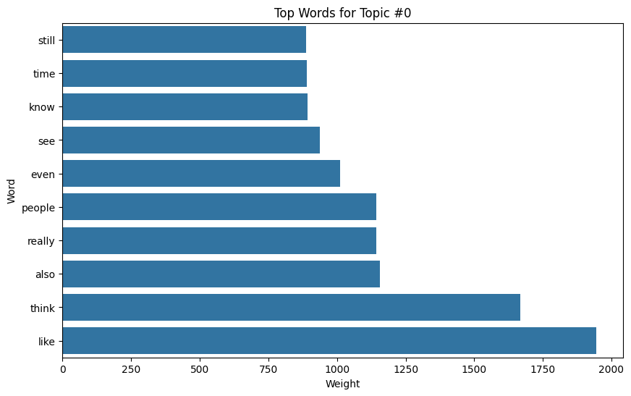
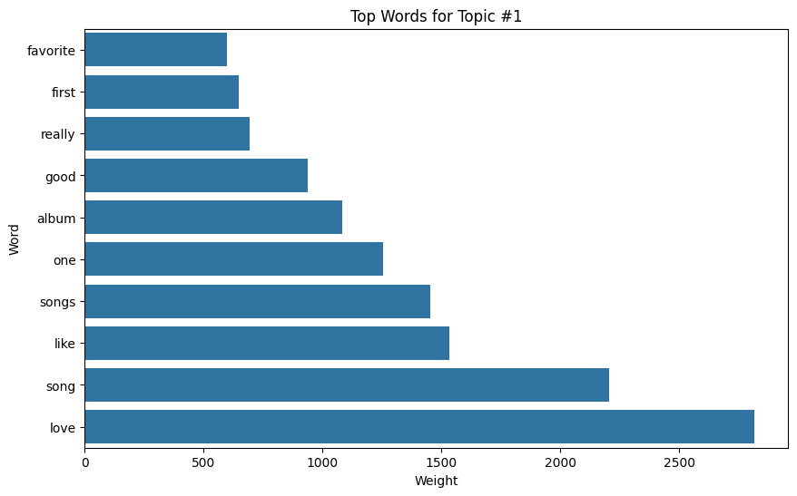
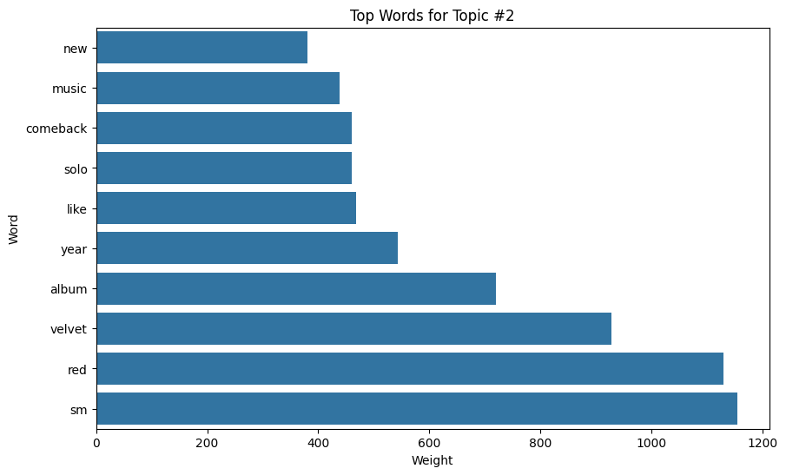
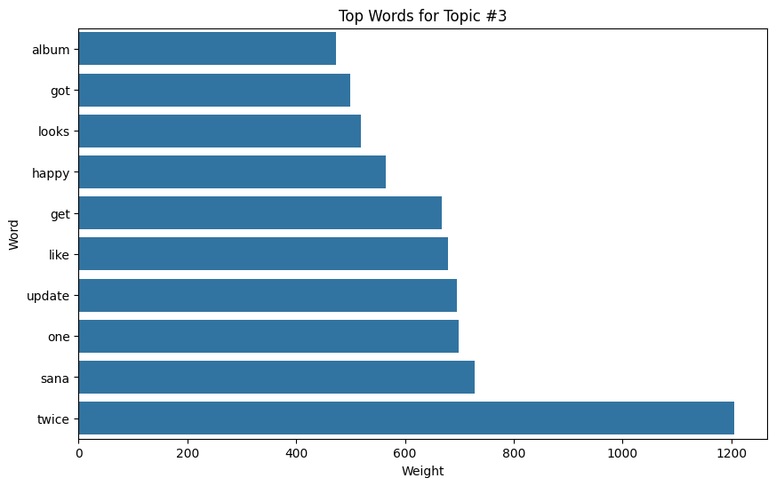
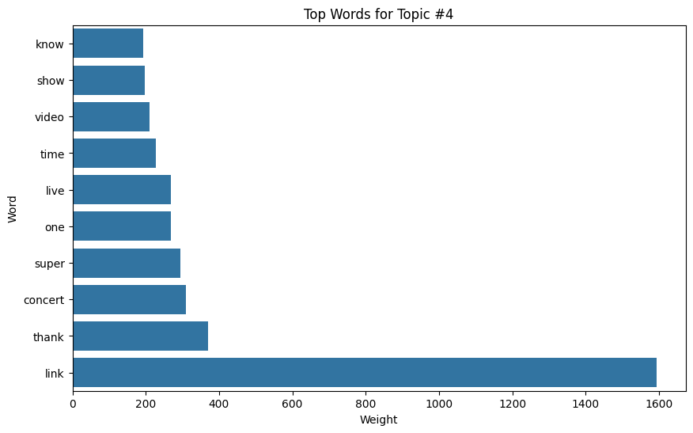
LDA

Slide 23
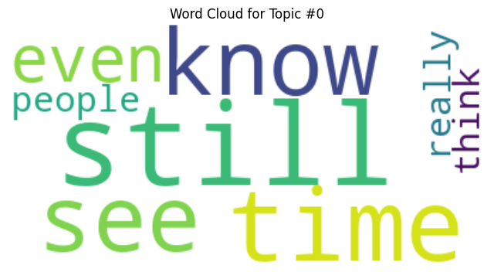
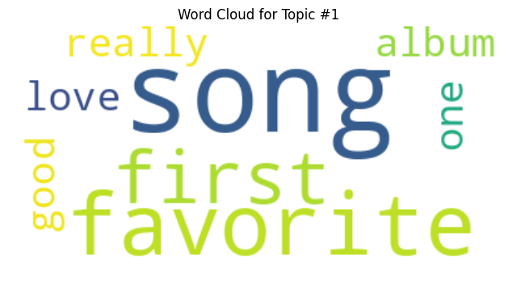
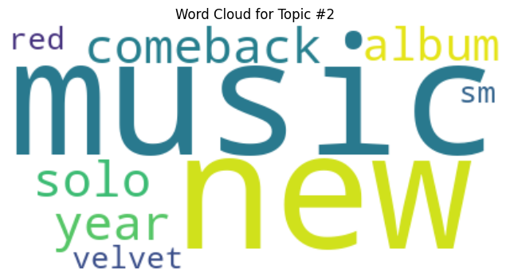
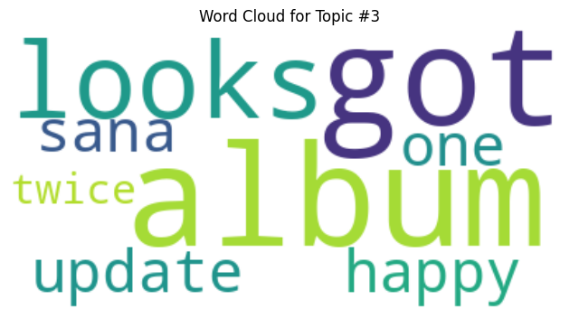
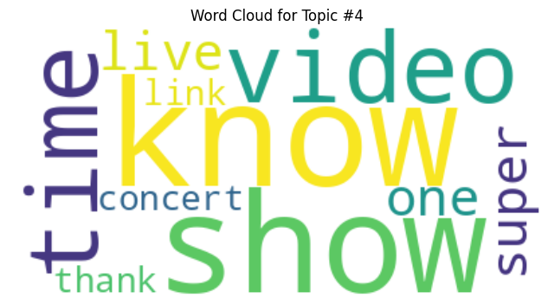
LDA

Slide 24
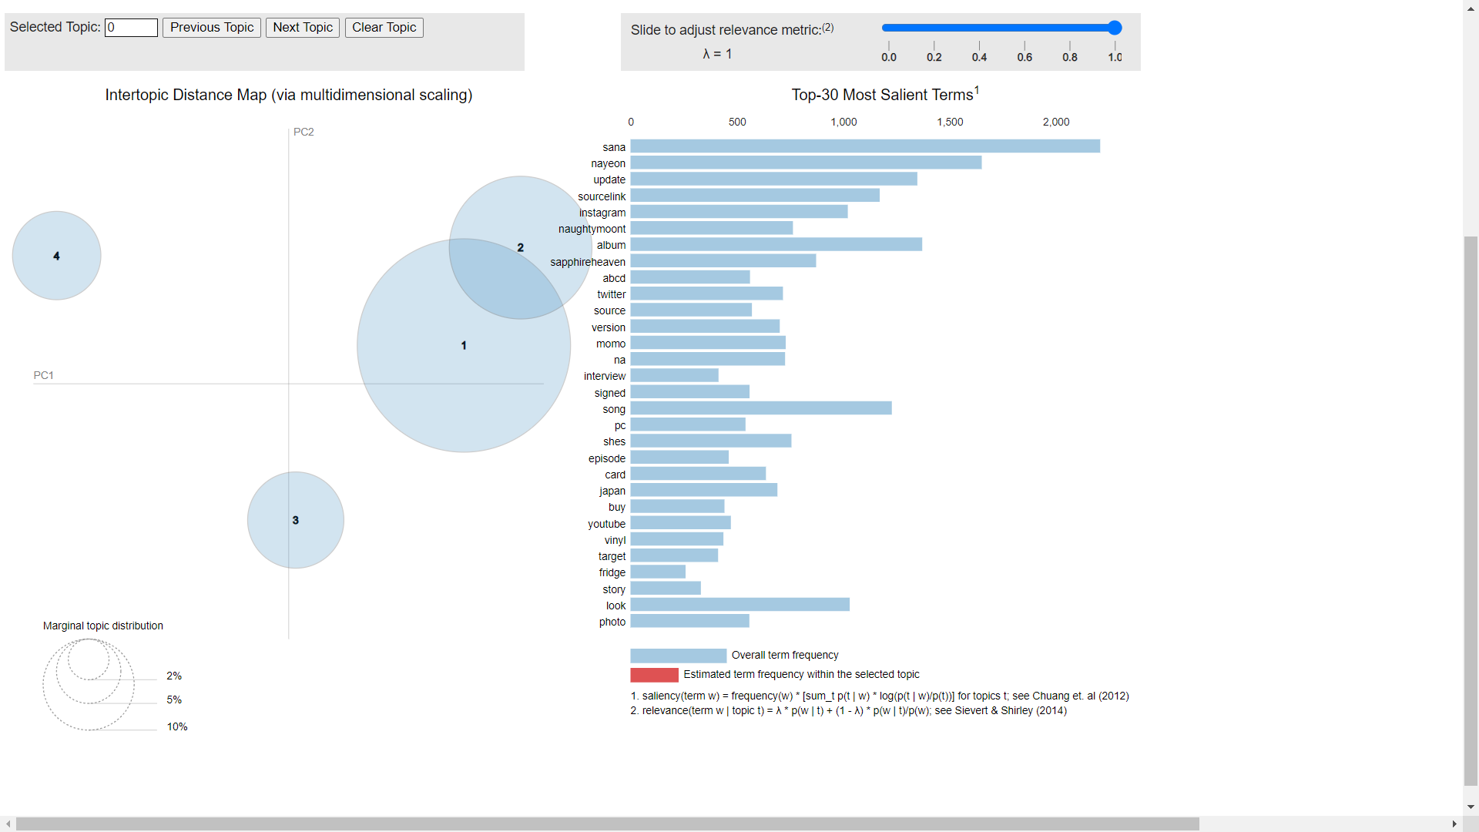
NMF
pyLDAvis Visualization
https://colab.research.google.com/drive/1fCk-UUciZ5K7PU3VJRm_F0ZgLcL9oXht?usp=sharing#scrollTo=wa_5zSsFiYi9

Slide 25




NMF
Word Cloud Representation

Slide 26


BERTopic
(Word Cloud Representation)

Slide 27

https://colab.research.google.com/drive/1WEyTHgLTv89rCHyVXXqS9DmF0HhZiN16?usp=sharing
BERTopic
(Bar Graph Representation)
https://colab.research.google.com/drive/1WEyTHgLTv89rCHyVXXqS9DmF0HhZiN16?usp=sharing

Slide 28
Results for Topic Modelling
Table: Evaluation using Coherence Score
Topic Model Used | Dataset Used | Coherence Score
BERTopic | Small Fandom | 0.5907
NMF | Small Fandom | 0.4623
BERTopic | Twice | 0.3912
NMF | Twice | 0.5227
LDA | Small Fandoms | 0.2765

Slide 29

THANK YOU

Slide 30
dsmff

